Slide 1

Internet Technologies
ITI & XI-IT
Lesson 5: Internet History
Henrik Lange

Slide 2
Plan
Week 1: HTML & CSS
Week 2: JavaScript
Week 3: HTTP, PHP & AJAX (march 1st)
Week 4: MariaDB / MySQL (march 8th)
Week 5: Recap, Internet History, Project help (march 15th)
Week 6: Project Hand-In (march 22nd)
Week 6: OOP PHP, MVC, Routers, Reflection
Week 6: Midway Evaluation
Week 7: Project Presentation (march 29th)
Week 7: Assignment 2 specification
Week 8: API’s and Frameworks

Slide 3
Agenda
The Internet
Internet History
Web 2.0
Mobile Web
The Web today
Recap
HTML
CSS
JavaScript
PHP
MySQL
Project Help

Slide 4
What is the internet?
…

Slide 5
What is the internet?
A global network of computers
A tool for communication and knowledge sharing

Slide 6
What is the internet for?
…

Slide 7
What is the internet for?
Gaming
Communication
Sharing knowledge and data
Social media
Check time and location
Streaming and downloading music and video
Shopping
Banking
Identification
Something even more important/serious?

Slide 8
Beginnings
The internet was started as a US weapon during the cold war
A response to USSR launching Sputnik
ARPANET was used to communicate without interference and disruption across great distances
Defense’s Advanced Research Projects Agency Network

Slide 9
Beginnings
1970’s:
More computers added to the network
Vinton Cerf developed TCP and later added IP
TCP/IP
Gives every computer an identity (IP)
Handshakes data packages (TCP)
1980’s
More researchers started using the network
56k modems become the norm
DNS is introduced

Slide 10
Early days
1988:
Worm virus affects ~10% of the 60.000 computers on the internet
1990:
ARPANET ceases to exist
1990:
First ISP
world.std.com

Slide 11
Public
1991:
Tim Berners-Lee
Created first version of HTML
Created the first GUI web browser
Called “World Wide Web”
1992:
Students at University of Illinois developed a better browser
Pictures and text on the same site
Clickable links
Scrollbars
Project Mosaic later became Netscape

Slide 12
Public
1992:
Internet was made publicly available by congress decision
Companies started creating websites
1995:
Traditional online dial-up systems are offered by vendors
America Online, Compuserve, Prodigy

Slide 13
Public
1995:
Traditional online dial-up systems are offered by vendors
America Online, Compuserve, Prodigy
1994-2000:
Internet exploded in size
1994:
Amazon launches as a bookstore
1995:
Yahoo and Jubii founded
Web archives with content registration

Slide 14
Google
Founded in 1998
Relied on a web crawler, rather than registration
Crawls alphabetically and by following links
Ordered search results by rank
Rank was set by number of links pointing to a site

Slide 15
Web 2.0
Participatory Internet
Sites are no longer static
Users can upload their own content and comment on it

Slide 16
Web 2.0 sites
2001: Wikipedia
Online encyclopedia
Entries made and edited by users
2003: MySpace
Users can have their own mini website
Heavy focus on music
2005: YouTube
Utilizes Flash to enable video streaming
2006: Facebook opens to the public
Yearbook-style profiles rather than mini sites
“Updates” and “Walls”

Slide 17
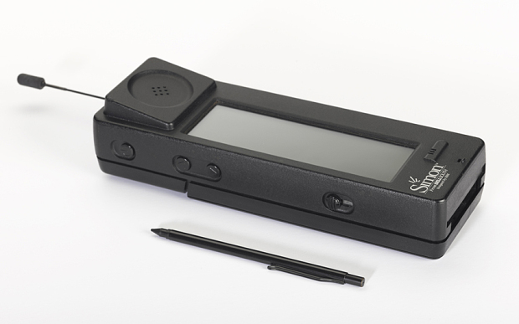
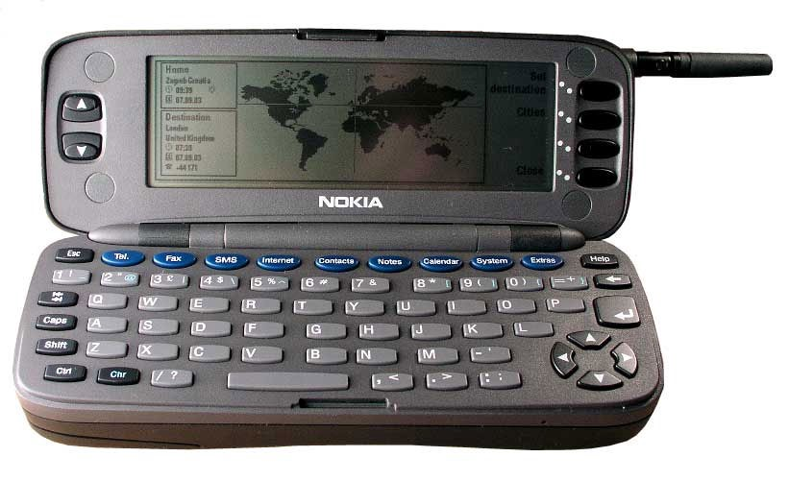
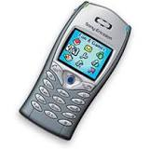
Smartphones
1992:
IBM Simon
First TouchScreen phone
1996:
Nokia 9000 Communicator
First mobile with internet access
2001:
Sanyo SCP-5000
First mobile with color screen

Slide 18
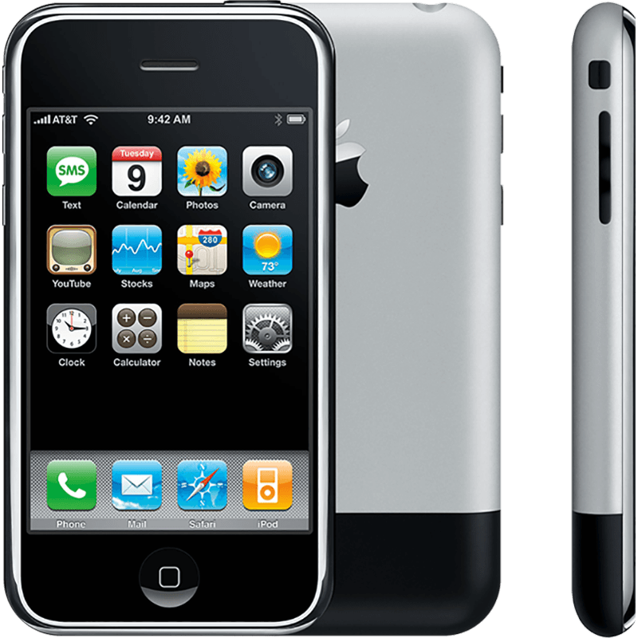
iPhone
2007:
iPhone
Capacitive Touch Screen
Fingersized icons
Full web browser

Slide 19
Opera Mini
2005:
Opera Mini
Enables browsing of the “normal” web on mobile
VPN servers downscaling content

Slide 20
The Web Today
Torrent Networks
VPN’s
Onion sites
Privacy
Targeted advertising

Slide 21
The Future of the Web
Augmented and virtual reality?
Will robots take over our jobs?
Will apps be more common that websites?
Internet of things
Internet access from other planets?
New technologies
Will we get more or fewer internet programming jobs?

Slide 22
HTML Recap
Let’s take a look at W3Schools HTML Quiz
https://www.w3schools.com/hTml/html_quiz.asp

Slide 23
CSS Recap
Let’s take a look at W3Schools CSS Quiz
https://www.w3schools.com/css/css_quiz.asp

Slide 24
JavaScript Recap
Let’s take a look at W3Schools JavaScript Quiz
https://www.w3schools.com/js/js_quiz.asp

Slide 25
PHP Recap
Let’s take a look at W3Schools PHP Quiz
https://www.w3schools.com/pHP/php_quiz.asp

Slide 26
MySQL Recap
Let’s take a look at W3Schools MySQL Quiz
https://www.w3schools.com/sql/sql_quiz.asp

Slide 27
Next time
Assignments should be handed in before midnight on march 22nd!
OOP PHP, Routers, Reflection, MVC

